Slide 1
WELCOME

Slide 2
Part Two
Collective Employment Relationships

Slide 3
What is it?
Is a relation of an employer or employers ‘associations with trade unions or collectively of trade unions
It Includes Formation of industrial organization
And collective agreement and bargaining

Slide 4
Applicable Provisions
Article 31 and 42(1)(a) of the constitution
Art 134- 135 of the Labour proclamation
ILO Conventions on Freedom of Association and Protection of the Right to Organise, 1948 (No. 87),
ILO Conventions and the Right to Organise and Collective Bargaining, 1949 (No. 98).

Slide 5
Chapter Six:- Industrial organizations and Collective agreement

Slide 6
6.1 Industrial organization
It includes the trade unions and Employers’ association
Trade union is the association of employees while employers association is comprised of employers.

Slide 7
Historical Background of I. O
Formation of associations of employees was considered as conspiracy and hence criminal offence.
Trade unionism were attacked by every quarter of the society. i.e. they were considered as illegal
Industrial revolution give birth to trade unionism.
Through passage of time and ever since the establishment of ILO as a world body, however, the right to form association has been one of the fundamental rights for both the employees and employers.

Slide 8
The ILO convention, protect associations from external interference and prohibit anti-union discrimination.
Moreover the Revised Ethiopian Constitution of 1955 under Article provided that ―every Ethiopian subject has the right to engage in any occupation and to that end form an association”.
Proclamation No.210/1963 that detailed implementation procedures were provided.
Proc. No.64/1975) was adopted by dergue. It, however, failed to provide legal framework for employers to form associations.
It was with the coming into effect of Proc. No.42/1993 that employers ‘associations regained clear legal framework of establishment.
See also the FDRE constitution

Slide 9
As regards to formation of association for civil servants however, the issue is not yet settled.
The FDRE constitution (Art.42 (1).‖ and (Art.42 (1) (c)).
As regards to the labour regime, however, under the existing laws, both employees and employers are entitled to form associations of their own choice without interference from any corner.
Denying employers from forming associations was in contravention of Convention No.87 to which Ethiopia has been a party since 1963.

Slide 10
Not only the right to form association but also that the right to form more
Than one association in an enterprise (i.e. the concept of plurality (diversity) of unions) has been incorporated into Ethiopian labour law.

Slide 11
Purposes of Industrial organizations
To protect collective interest of workers
Collective bargaining:- to create a fertile ground where workers and employers could collectively negotiate with each other concerning wages, hours of work and condition of work.
For the employer: to avoid disorganized way of movement (ex. strike)
To secure peace and stability in industrial life.

Slide 12
The right to form organization(association)
Both the worker and employer should be given the right to form their organization to promote social and economic interest.
Forming an international organization is vital both for the employer and employee for effective realization of their legally recognised rights and interests
Art. 113(1) LP

Slide 13
The right to form association includes:
The right of workers and employers to form their own organization without any interference or influence
To prepare their own constitution
To choose the leader of their own organization freely and fairly
To formulate and design programme and objectives of their organization.

Slide 14
The right includes
Freedom to join a certain TU
Not to join a certain TU
To withdraw from TU

Slide 15
Plurality of unions
The current labour law recognized the plurality of trade unions in a single enterprise.
If so will the employer be compelled to bargain with every union or is there a way out? See Art 115(1(a))
The law enshrined the concept of the ―most representative union which will possess the power of being an exclusive bargaining agent.

Slide 16
Preconditions to enjoy the right:-
Minimum No of workers;- Art. 114(1)
At least 10 workers.
Workers whose NO is less than 10 do have the right to form association. i.e. General Trade Union of two or more undertaking
But the sum must not be less than 10

Slide 17
2. Having a constitution:
Is a document which the objective of the union and the rights and duties of the member, their relationship with the union.
Art 117
Must be submitted to MOLSA

Slide 18
3. Registration
By MOLSA
Art 118
Registration as envisaged by the law could take two forms; actual and default registration.
Actual registration occurs where the registering organ is provided with the necessary documents and found the documents adequate and legal after which it entered the registration (Art.118 (3) first sentence).
Default registration, on its part, occurs when the registering organ upon being provided with the necessary documents failed to respond positively or negatively on the application for fifteen days from the date of receipt of the documents. Hence, in such circumstances silence amounts to acceptance (Art.118 (3) second sentence.).

Slide 19
Effects of non-registration Art 118(4)
Effects of registration Art 118(5)
Grounds of Refusal Art 119
Cancellation of registration Art 120 and 121 with Art 123
Appeal Art 122

Slide 20
Formation of employers association
The requirement of constitution and registration applies here too.
But the law is silent abt minimum no of members
In absence of the law….

Slide 21
Federation 113(2)
federation of TU is established by one or more TU jointly
Federation of employers association; established by one or more EA
Confederation: Art 113(2)
Of TU- established by one or more federation of TU.
Of EA: established by one or more federation of EA

Slide 22
Functions of the trade union and Employers association
Art 15 and 16 of LP
Federation and confederation Art. 116
What about political involvement?
See Art (3)(1) of ILO convention No 87

Slide 23
Collective bargaining and collective agreement
Collective Bargaining
Is the process of collective negotiation
Is the process through which the workers negotiate with their employer
Art 154(2) of ILO convention:
Art 124(2) LP
It presupposes the existence of TU

Slide 24
Recognized worldwide as a crucial for bringing industrial democracy
Philadelphia declaration:- ILO has the solemn obligation to further among the nation of the world.
The 1998 ILO convention obliges member states of ILO to promote and realize the principles concerning the right to bargaining.
See convention No 98 and 154

Slide 25
Parties to the collective bargaining
As a principle The right to CB applies to all workers organization and Employers organization
As an exception; certain sectors of workers or organization are excluded under domestic law
ILO conventions provided about the exclusions of armed and police force.
See also Art 125 and 126 of LP
CB must be made with the full and free consent of the parties

Slide 26
Procedural requirements
Must be made with full and free consent of the parties
Request: Art 130(1) must be made in writing
Duty to bargain in good faith
Purposes
The purpose of collective bargaining is the regulation of terms and conditions of employment, in a broad sense, and the relations between the parties.
Collective agreements should be binding.

Slide 27
Principles of collective bargaining
Principles of good faith
Implies recognizing representative organizations, endeavouring to reach an agreement, engaging in genuine and constructive negotiations, avoiding unjustified delays in negotiation and mutually respecting the commitments entered into, taking into account the results of negotiations in good faith.
The principle of independence
The organization must not be under the influence of employer or employers organization
The Principle of autonomy of the parties
The principle of Free and voluntary nature of the Negotiation

Slide 28
Collective agreements
Is the result of collective bargaining
Art 114
The subject matter of collective agreement:-
Specified under Art. 128 and Art 129
Collective agreement have two major function
It deals with issues important to the TU as an entity and the employer employer’s organization
Ex. Negotiation right, do not bind the individual parties.
Issues relevant to the individual employee: example occupational safety and health, arrangement of working hours.

Slide 29
Enforceability of terms of collective agreement
Art 139
Art 135(1)
Collective agreement is a legally binding agreement at both collective and individual level.
It is also likely to affect the individual employees
The employer may claim the terms of collective agreement against an employee

Slide 30
The employee too, may claim the terms of CA against employer as per Art 134 and 135 of LP so long as it is favourable to the employee
Is CA valid against binding against a non-member of TU
The agreement shall not be made applicable to some workers who are member of TU by excluding non-members.
Any activity that discriminate between workers and members of TU is contrary to the constitution and some other instruments.
So non-members must be beneficial.

Slide 31
If so, what should cover the cost of bargaining? Normally it is covered by the TU from the income collected from employee?
Making the CA applicable to all workers would perhaps amount to giving undue advantage to non-member workers at the expense of members to TU who pays membership fee.
Solution; 1. Making all workers to share the costs incurred the bargaining process
2 doesnot it amount to force workers to join TU?

Slide 32
Conditions for the validity of collective agreement
As a contract it should fulfil all the requirements of a valid contract.
FORM
Must be made in writing
Should indicate parties to the collective agreement
Signature by representatives
Date on which it entered in to force unless Art 133(2)

Slide 33
Registration
MOLSA
Why? To allow the minister to follow developments in collective bargaining
To determine whether there is any legal defect in the agreement and inform parties
Duration of the contract Art 133(3); 3 years
Content: A CA is expected to satisfy the minimum standard set by the law Art 133(1)

Slide 34

Definition
Collective bargaining is a type of negotiation used by employees to work with their employers.
During a collective bargaining period, workers' representatives approach the employer and attempt to negotiate a contract which both sides can agree with.
Typical issues covered in a labor contract are hours, wages, benefits, working conditions, and the rules of the workplace.
Once both sides have reached a contract that they find agreeable, it is signed and kept in place for a set period of time, most commonly three years.
The final contract is called a collective
bargaining agreement, to reflect the fact
that it is the result of a collective
bargaining effort.
The parties often refer to the result of
negotiation as a Collective Bargaining
Agreement (CBA) / as a Collective
Employment Agreement (CEA).

Slide 35

Features:
It is a collective process.
The representatives of both workers and management participate in bargaining.
II. It is a continuous process. It establishes regular and stable relationship between the parties involved. It involves not only the negotiation of the contract, but also the administration of the contract.
III. It is a flexible and dynamic process. The parties have to adopt a flexible attitude through the process of bargaining.
IV. It is a method of partnership of workers in management

Slide 36
Importance to society
Collective bargaining leads to industrial peace in the country.
It results in establishment of a harmonious industrial climate which supports, which helps the pace of a nation’s efforts towards economic and social development since the obstacles to such a development can be reduced considerably.
The discrimination and exploitation of workers is constantly being checked.
It provides a method or the regulation of the conditions of employment of those who are directly concerned about them.

Slide 37
Importance to employers
It becomes easier for the management to resolve issues at the bargaining level rather than taking up complaints of individual workers.
Collective bargaining tends to promote a sense of job security among employees and thereby tends to reduce the cost of labor turnover to management.
Collective bargaining opens up the channel of communication between the workers and the management and increases worker participation in decision making.
Collective bargaining plays a vital role in settling and preventing industrial disputes.

Slide 38
Importance to employees
Collective bargaining develops a sense of self respect and responsibility among the employees.
It increases the strength of the workforce, thereby, increasing their bargaining capacity as a group.
Collective bargaining increases the morale and productivity of employees.
It restricts management’s freedom for arbitrary action against the employees..
The workers feel motivated as they can approach the management on various matters and bargain for higher benefits.
It helps in securing a prompt and fair settlement of grievances.
It provides a flexible means for the adjustment of wages and employment conditions to economic and technological changes in the industry, as a result of which the chances for conflicts are reduced.
Impasse

Slide 39
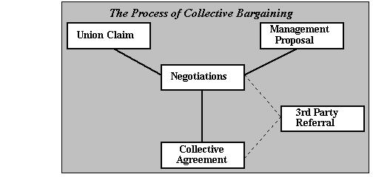
Collective Bargaining Process
In many companies, agreements have a fixed time scale and a collective bargaining process will review the procedural agreement when negotiations take place on pay and conditions of employment.

Slide 40

(1) Prepare
This phase involves composition of a negotiation team.
The negotiation team should consist of representatives of both the parties with adequate knowledge and skills for negotiation.
In this phase both the employer’s representatives and the union examine their own situation in order to develop the issues that they believe will be most important.
A correct understanding of the main
issues to be covered and intimate
knowledge of operations, working
conditions production norms and
other relevant conditions is
required.

Slide 41
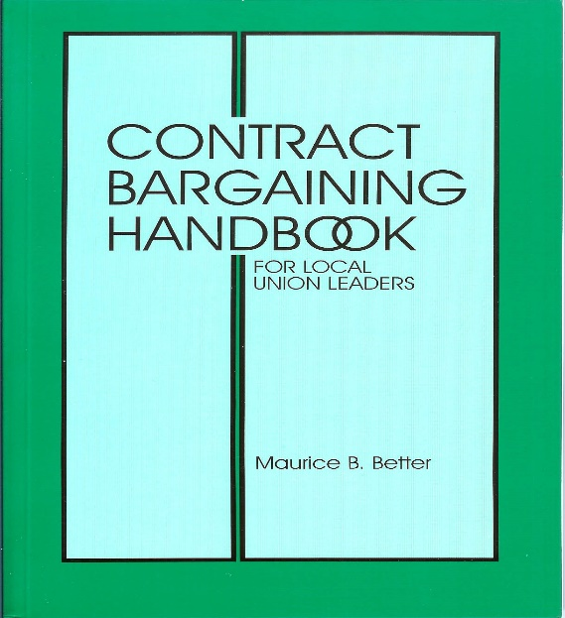

(2) Discuss
The parties decide the ground rules that will guide the negotiations.
An environment of mutual trust and understanding is also created so that the collective bargaining agreement would be reached.

Slide 42
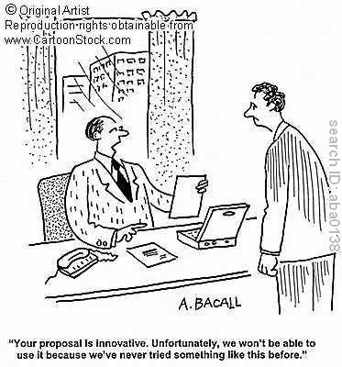
(3) Propose
It involves the initial opening statements and the possible options that exist to resolve them. In a word, this phase could be described as ‘brainstorming’. The exchange of messages takes place and opinion of both the parties is sought.

Slide 43
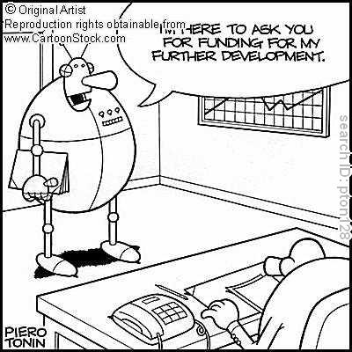

(4) Bargain
Negotiations are easy if a problem solving attitude is adopted.
This stage comprises the time when ‘what ifs’ and ‘supposals’ are set forth and the drafting of agreements take place.

Slide 44

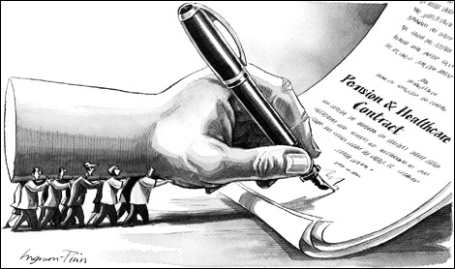
(5)Settlement
Once the parties are through with the bargaining process, a consensual agreement is reached upon wherein both the parties agree to a common decision regarding the problem or the issue.
This stage is described as consisting of effective joint implementation of the agreement through shared visions, strategic planning and negotiated change.

Slide 45
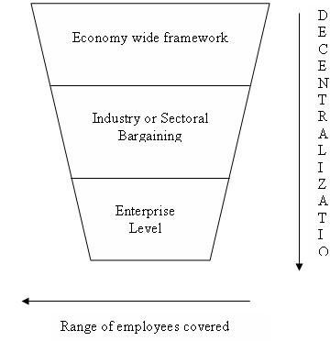

Levels of collective bargaining

Slide 46


